Slide 1
CUSTOMER RETENTION PROJECT

Slide 2
Agenda
Problem statement
Executive summary
EDA
Tools
Steps and Visualization
Analysis
Conclusion and next steps

Slide 3
Problem statement
To give finding and conclusion in detailed analysis that indicate the e-retail success factors, which are very much critical for customer satisfaction.
Which variables can help the website/companies for customer retention.
Data source- The research, references and data source I got for this Customer retention project from Flip robo technologies which guided me to get complete analysis through this project.

Slide 4
Executive summary
Customer satisfaction has emerged as one of the most important factors that guarantee the success of online store; it has been posited as a key stimulant of purchase, repurchase intentions and customer loyalty. A comprehensive review of the literature, theories and models have been carried out to propose the models for customer activation and customer retention. Five major factors that contributed to the success of an e-commerce store have been identified as: service quality, system quality, information quality, trust and net benefit. The research furthermore investigated the factors that influence the online customers repeat purchase intention. The combination of both utilitarian value and hedonistic values are needed to affect the repeat purchase intention (loyalty) positively. The data is collected from the Indian online shoppers.

Slide 5
EDA
there are no null values
most data type is object data type only, There is only 1 numerical column present in the dataset, one column of pin code is numerical
There is 70 columns present in dataset and univariate analysis is done via count plot mostly using sea born package.

Slide 6
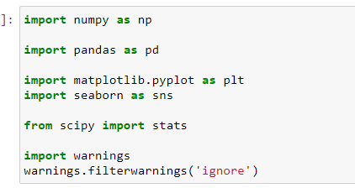
Tools
the hardware and software requirements along with the tools, libraries and packages used-
These packages were used for making lot of graph to check the effect on sale prices and for data cleaning and feature engineering

Slide 7
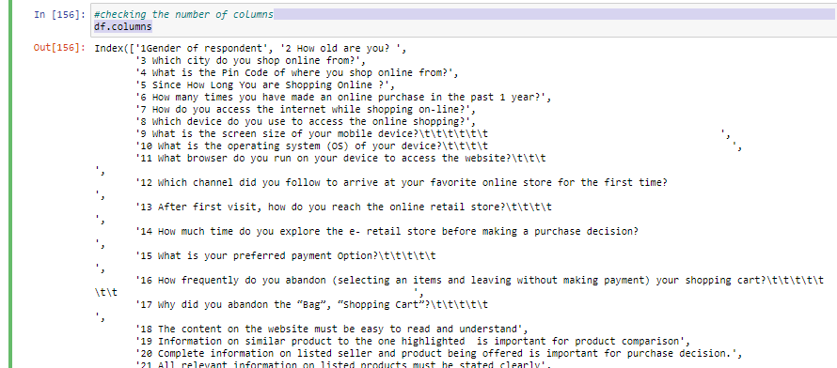
Steps and Visualization
Above are all parameters that can be benificiary for the company for customer retention

Slide 8
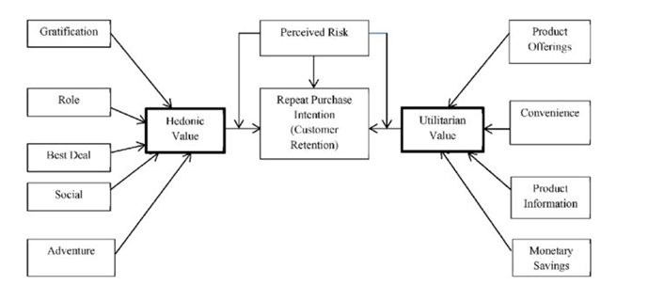
Visualization
Summarising companies customer retention model parameters to have balanced customers

Slide 9
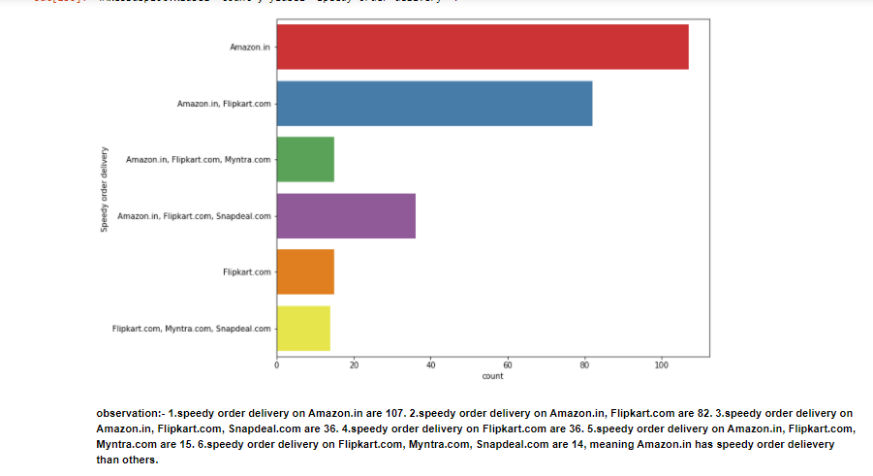
Visualization
Types- count plot were used mostly as data was categorical and observation were analysed for all.

Slide 10
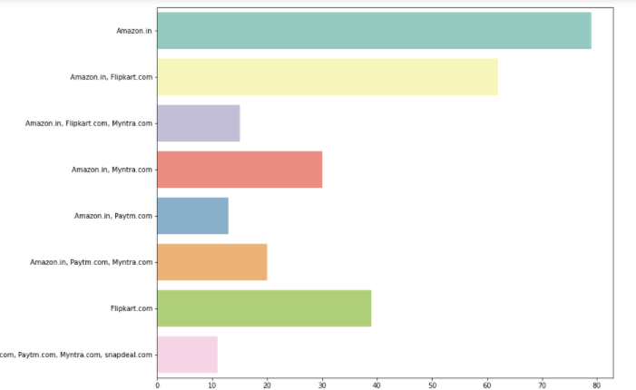
Analysis
After all observation analysis Amazon.in, flipkart.in were most reliable websites in every parameter and can be recommended easily to new customers.

Slide 11
Conclusion and next steps
My key findings are the mostly parameters where customer get satisfied with maximum information, best quality of product, number of mode of payments with speedy delivery, ease of access and after analysis Amazon.in and Flipkart.com are most reliable where customer gets satisfied with the number of parameter and these parameters will help companies for customer retention

Slide 12
Q AND A

